Slide 1
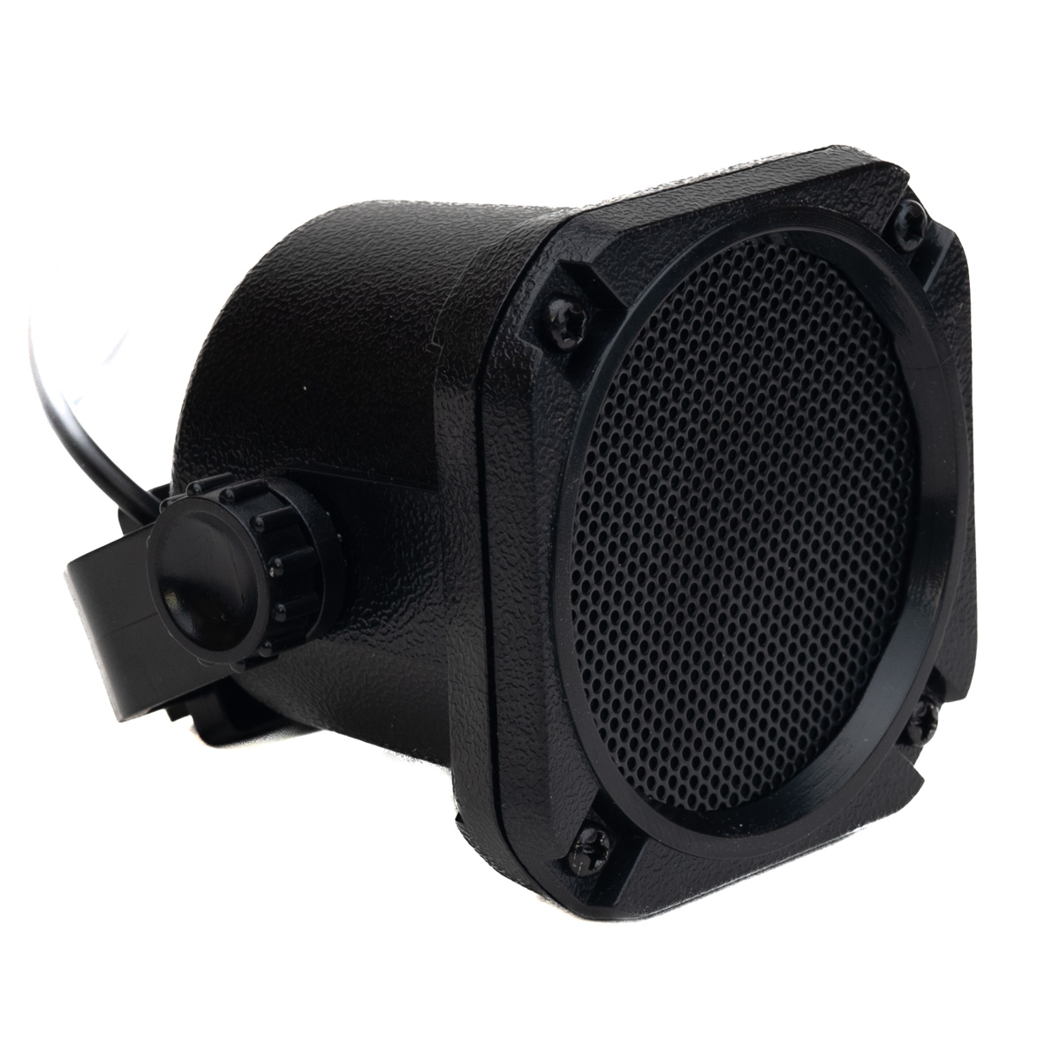
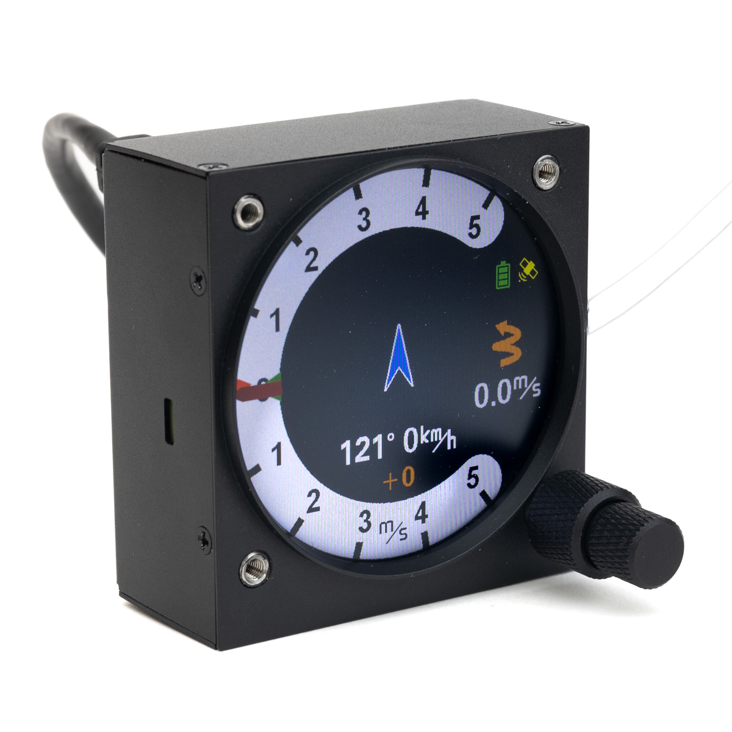
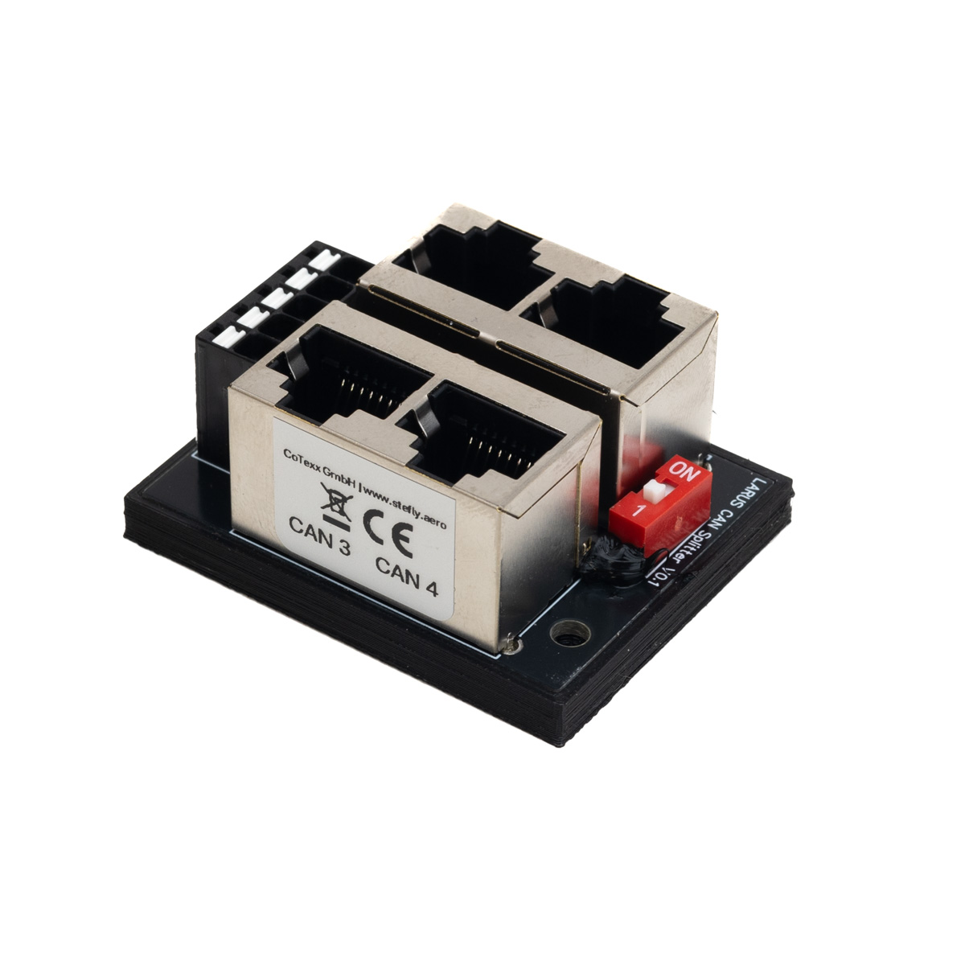

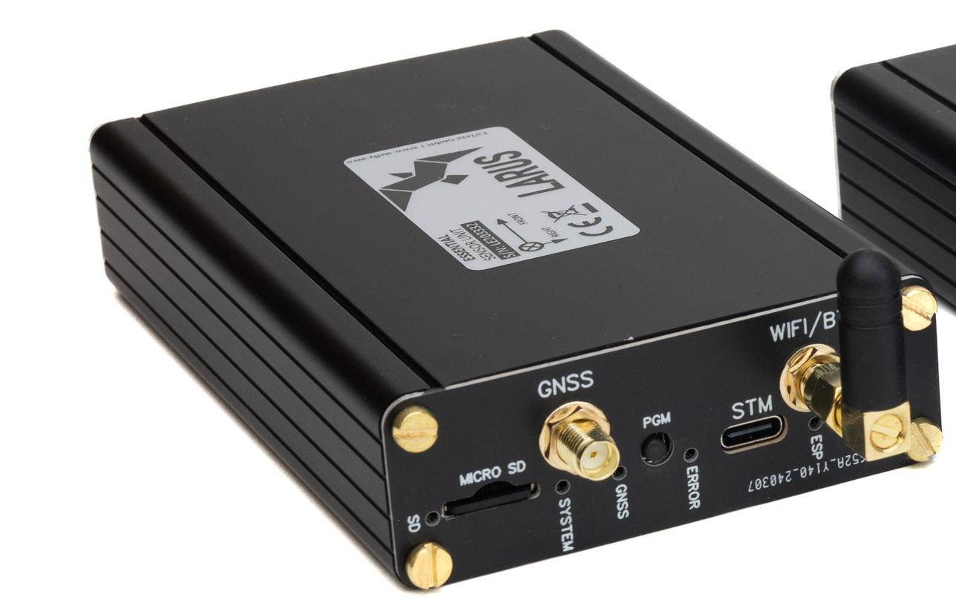
3,5 mm audio jack
1:1 patch cable
1:1 patch cable
CAN port
CAN port
CAN port
CAN port
RS232 port
CAN port
RS232 port
patch cable with RX / TX crossed
Option 1:
patch cable with RX / TX crossed
ttySx
CAN port
ttySx
Option 2:
patch cable with 1:1 patch cable
ttySx
RS232

